Slide 1


Team : SEAL Team 2

Slide 2
Student Management System
Team members
Lay Chhay
ID : e20200054
Koythol Amrint
ID : e20201757
Leat Senglong
ID : e20200971
BIG PROJECT –‚
Teacher : Chan Sophal

Slide 3
Purpose of project
1 . To apply lessons
2 . To help school’s management

Slide 4
Project Processing

Slide 5
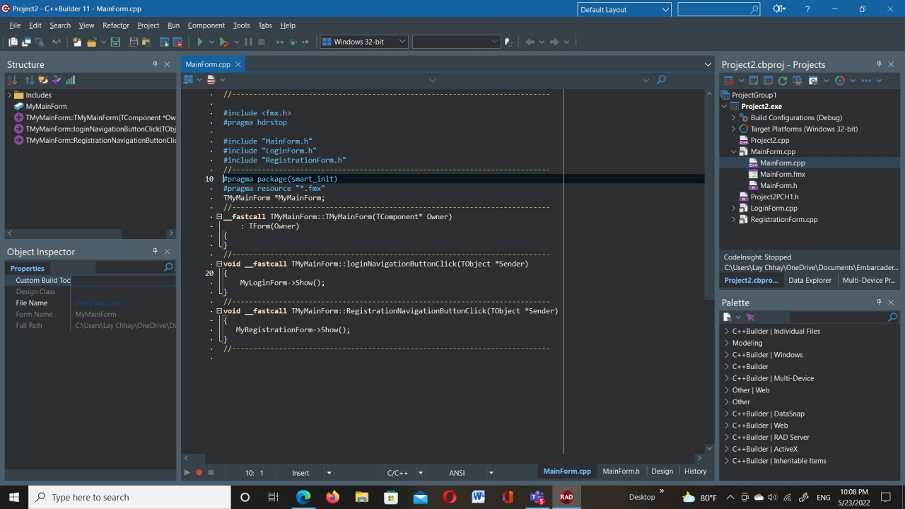

Slide 6
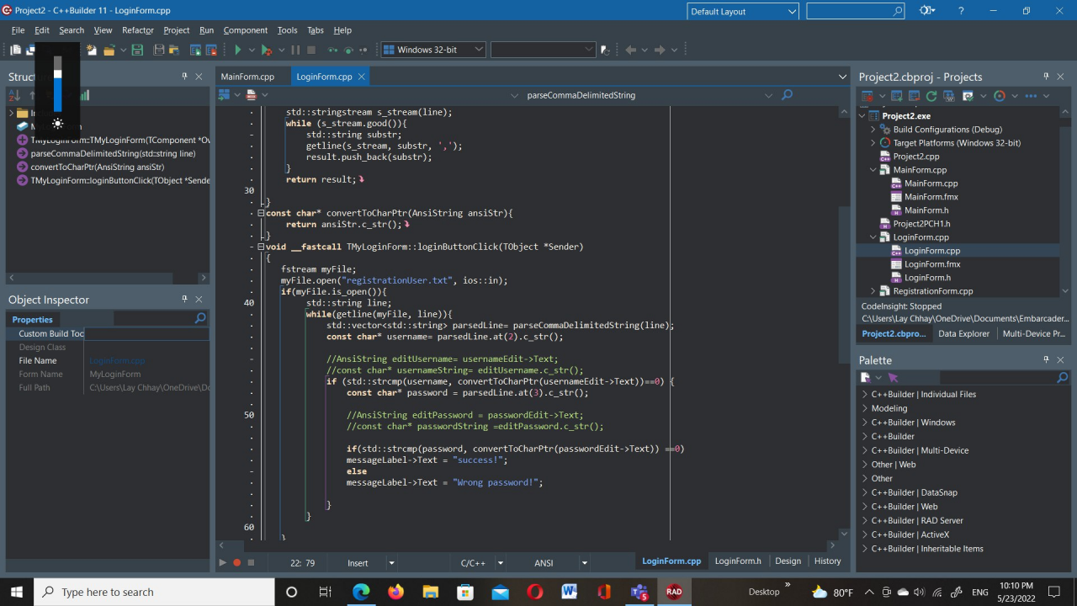

Slide 7
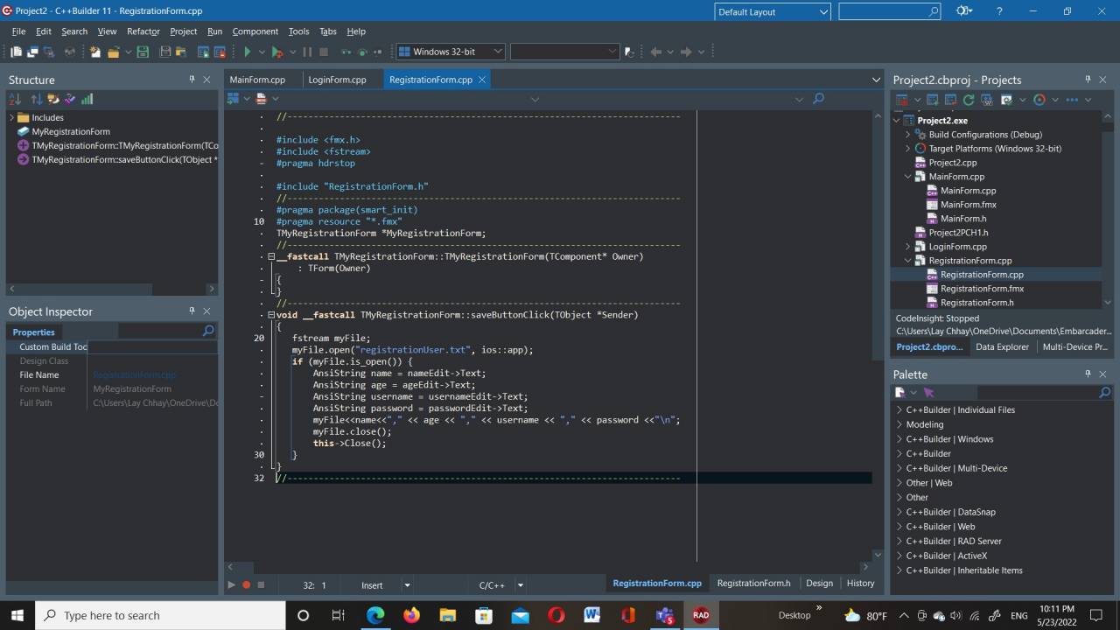

Slide 8
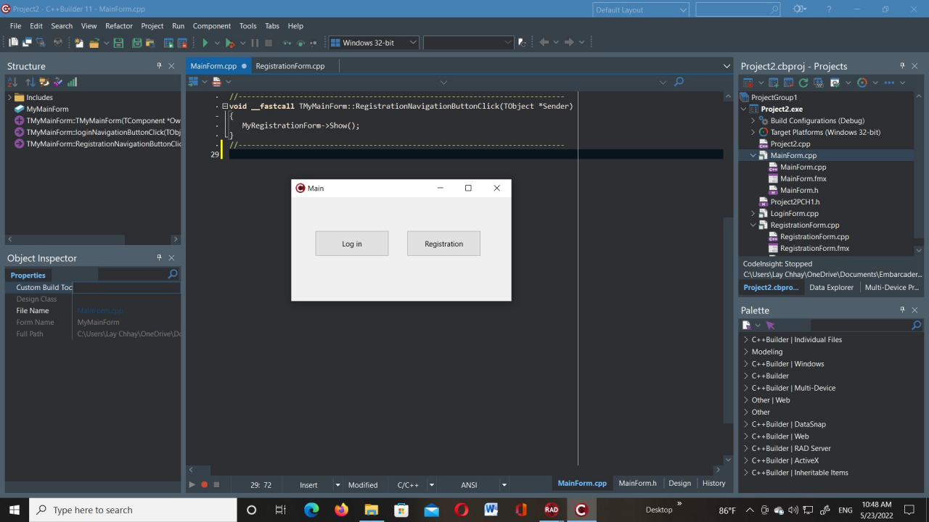

Slide 9
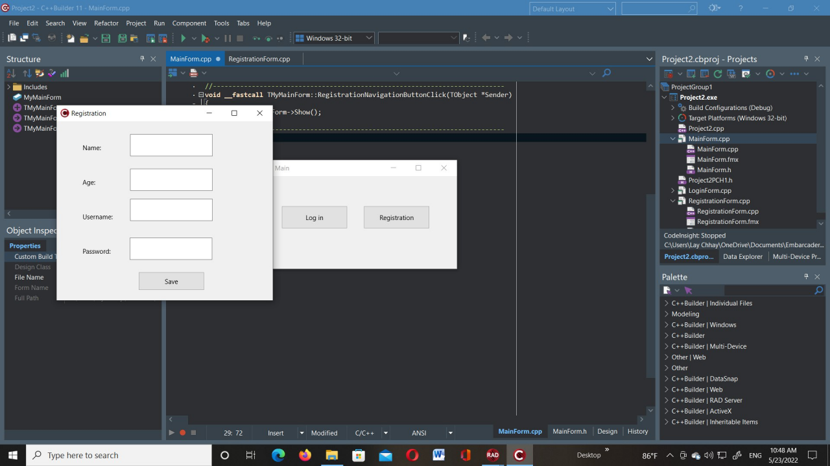

Slide 10
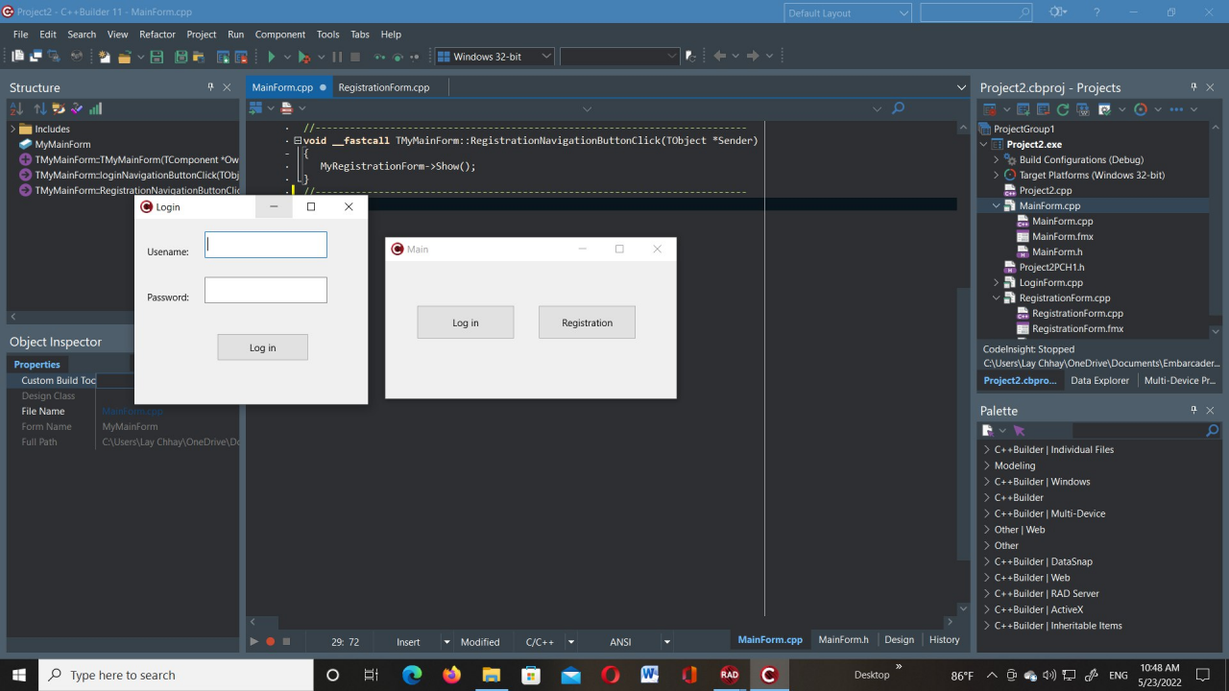

Slide 11

THANK YOU

